Slide 1




Ahmed Shaikh
SYIT – 232
Incharge: Prof. Priya Maurya
Computer Graphics & Animation

Slide 2
Colorimetry in Computer Graphics and Animation
Understanding color mapping.

Slide 3


TABLE CONTENT
INTRODUCTION
PRIMARY COLOR
RGB COLOR
APPLICATION OF COLORIMETRY
.

Slide 4


1. INTRODUCTION
What is Colorimetry?
Colorimetry in computer graphics is a field that deals with the measurement and representation of colors. It's all about how we can describe and reproduce colors accurately in digital images and displays.
Colorimetry is a fundamental concept in display test and measurement. It involves the measurement and analysis of color perception and reproduction. The human eye can detect millions of colors and shades, and colorimetry is used to ensure that displays accurately reproduce these colors.
A colorimeter is a device that is used in Colorimetry. It refers to a device which helps specific solutions to absorb a particular wavelength of light. The colorimeter is usually used to measure the concentration of a known solute in a given solution

Slide 5
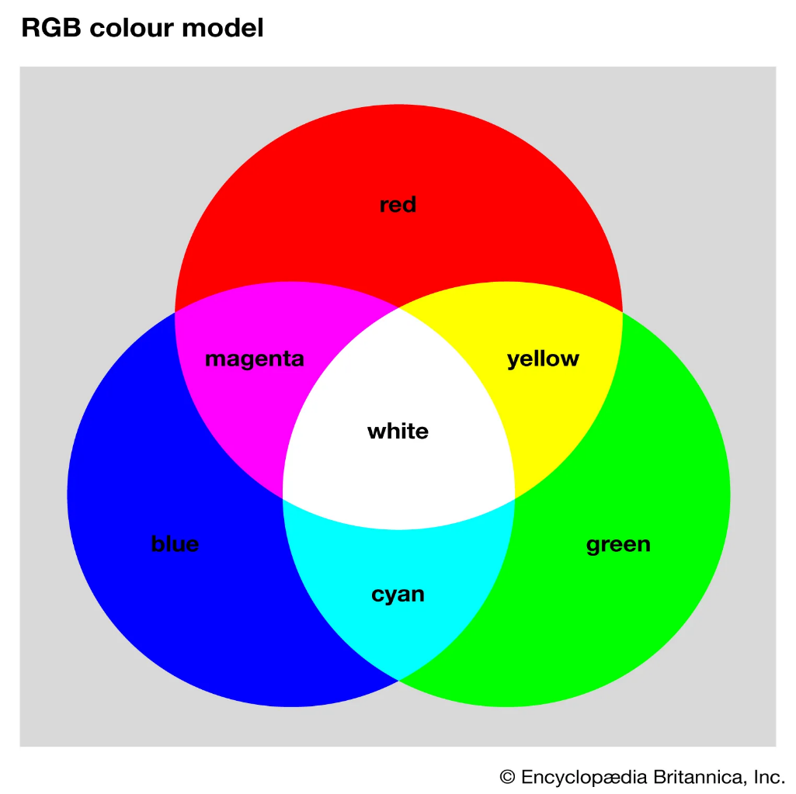
2. RGB Color
The RGB color model is one of the most widely used color representation method in computer graphics. It use a color coordinate system with three primary colors
Red Green Blue
The main purpose of the RGB color model is for the sensing, representation, and display of images in electronic systems, such as televisions and computers
RGB Color is also known as Primary Color

Slide 6
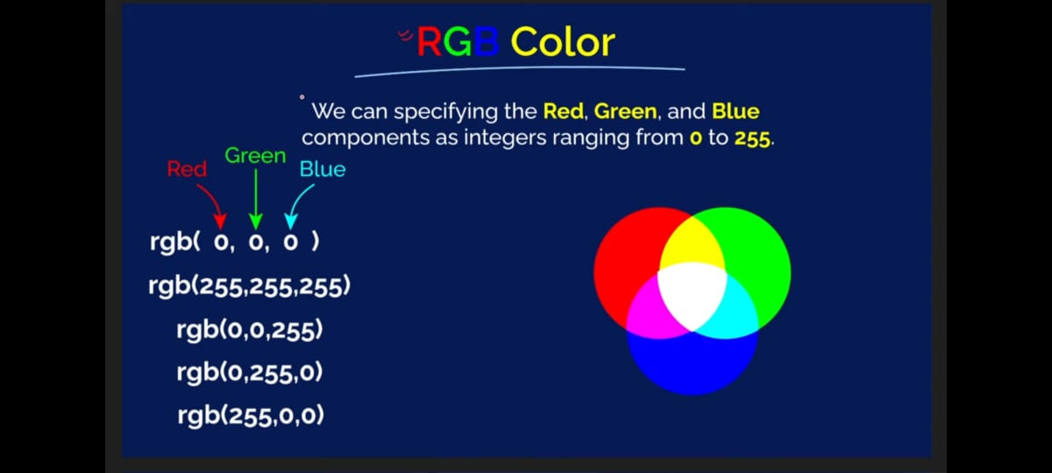

Slide 7


RGB in CSS
INPUT
OUTPUT

Slide 8
Color Formats in CSS

Slide 9

Applications of Colorimetry
The science of colorimetry is used to quantify the response of the human visual system and match human color perception for applications in a variety of industries.
Display Manufacturing:
Broadcasting:
Graphic Design and Computer Animation:
Quality control for industrial production lines and incoming inspection of display glass. Display calibration for LED, LCD, plasma, projection, DLP, CRT and LCOS displays.
Measuring and calibrating video walls for color accuracy, uniformity of brightness and white balance.
Professionals who rely on color accuracy and precision color measurement benefit from understanding colorimetry

Slide 10

Thank You

